Slide 1
Postgraduate Literacies & Research Skills Workshops
Workshop 2: Academic Research Project Planning and Management
Presented by :
Tapiwa Gundu (PhD)

Slide 2
Time management as a key to completion
Once you’ve planned a broader picture, need to manage time effectively. This consists of:
Prioritising
Estimating time
Scheduling
Managing interruptions

Slide 3
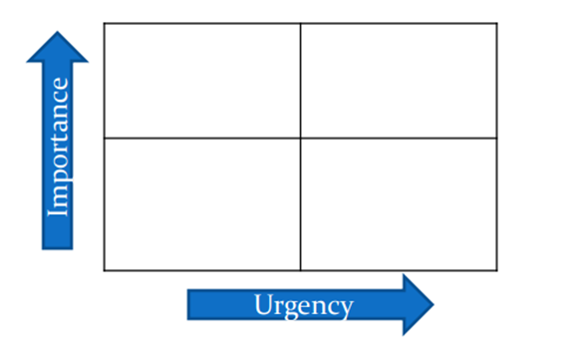
Time management as a key to completion......Cont
Think of the tasks that are required to complete an objective.
Prioritise these on the basis of importance and urgency:

Slide 4
Time management as a key to completion......Cont
Planning is a continual process
You will need to frequently review your plans
Start with detailed objectives
Work back to your grand plan
If you have concerns, talk to your supervisor about them!

Slide 5
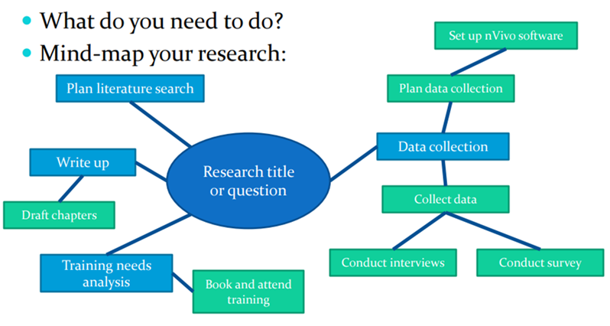
Ensuring no tasks are forgotten

Slide 6
Breaking large intimidating work into smaller achievable tasks
Look at the big picture; make sure you understand what the end product is supposed to look like.
Examine the parts of the task. Figure out step-by-step what you need to do because it’s not going to happen through magic.
Think about the logical order of completing the pieces. What should you do first, second, third, etc.?
Create a timeline for completing your tasks. Having a deadline will make you more focused for each task.
Have a plan to help you stay on track. Put the time you will spend on the project into your schedule so that you can set aside the time for it. Stick with this plan. A plan is only good if you see it through.
Complete your task early enough to have some time left for a final review.

Slide 7
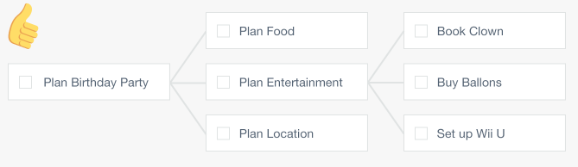
Breaking large intimidating work into smaller achievable tasks…..Cont

Slide 8
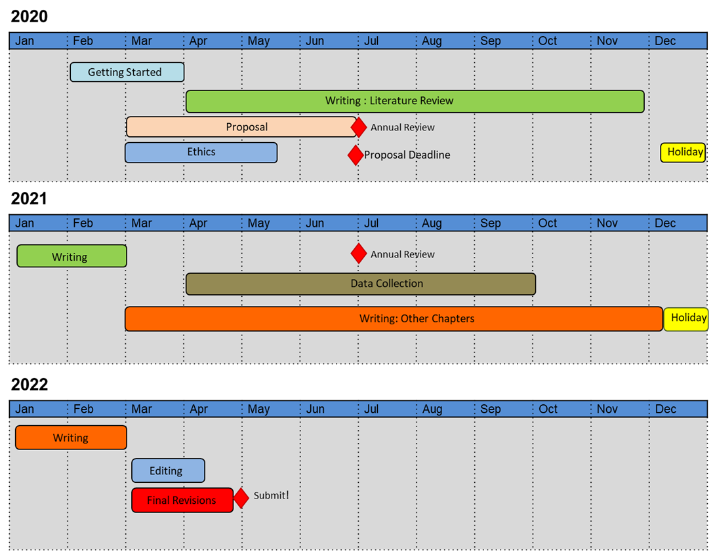
Gantt Charts

Slide 9
Meeting deadlines without stress
Sleep
Sleeping will not help you achieve deadlines. But it will help you think better.
Start Now
Not tomorrow. Not next week. Get a start now.
Work Backwards
Setting a deadline without logical thinking is a sure way to fail.
Add a Buffer
Life happens, don't set tight deadlines because you want to please your supervisor, and don’t overestimate your abilities.
Don’t Add Work
Once you add a buffer, the mind subconsciously eases down. If you feel the deadline is farther than it is, you feel tempted to slip in unnecessary tasks
Do Whatever It Takes
If it is a race against time, do whatever it takes.

Slide 10
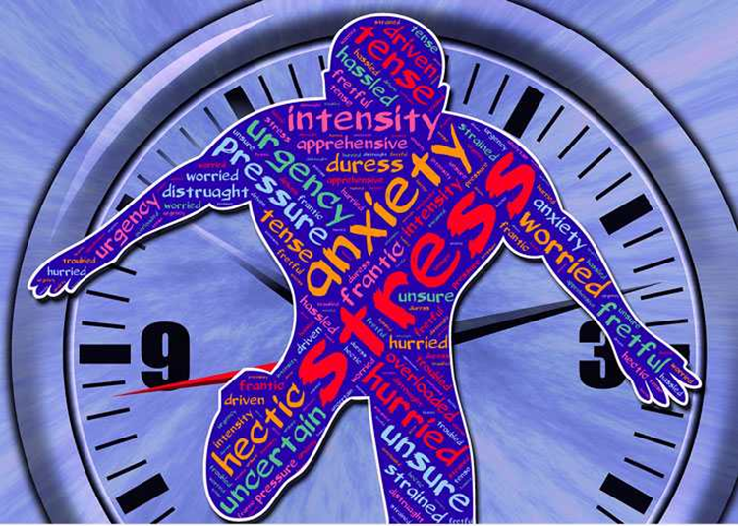
Meeting deadlines without stress….Cont
If You Will Miss a Deadline
Deadlines are not carved in stone. You will not meet them always. But informing the recipient about it in the dying moments is unprofessional.
If you will miss a deadline, give plenty of advance notice. Back it up with a valid reason and explain how much more time you need. People are okay extending a deadline as long as they are given a good reason in advance.

Slide 11
Working consistently
1. Isolate one goal.
Developing consistency goes against human nature. It’s burdensome, especially at first. It takes a lot of energy, a finite resource.
Don’t make the process even more challenging by trying to do too much all at once … The trick is to pick one goal to focus on at a time.
2. Focus on incremental improvement.
You’re not going to develop a positive, worthwhile habit overnight. Our brains don’t work that way, it may even take months. That’s a lot of patience and focus. That’s a lot of work.
Allow yourself to notice and celebrate the small wins, the incremental improvements you achieve along the way. They’ll keep you motivated.

Slide 12
Working consistently….Cont
3. Fight your emotions.
The brain uses a lot of energy, which is why we sometimes feel mentally sluggish or lazy, especially when faced with a challenge, like consistency.
Sometimes we really are tired. Sometimes, though, it’s a biological trick … Don’t fall for it. Push forward. Fight your emotions. If you don’t, you’ll stay stuck.
4. Forgive your failures.
That said, you are human, imperfect like the rest of us … As you pursue your consistency goals, you will get tired. You will stumble, You’ll miss a deadline
You’ll arrive late for a supervisor meeting
Whatever your goal may be, you’re bound to misstep from time to time – and that’s okay.

Slide 13

Adaptation to changes beyond your control
What do you do when unplanned or planned life events happen?
Readjust to the new situation
Revisit your expectations of self
Revisit your priorities
Relook at your time in your calendar
If possible delegate
Ask for help

